Slide 1
Hodgkin-Huxley equations

Slide 2
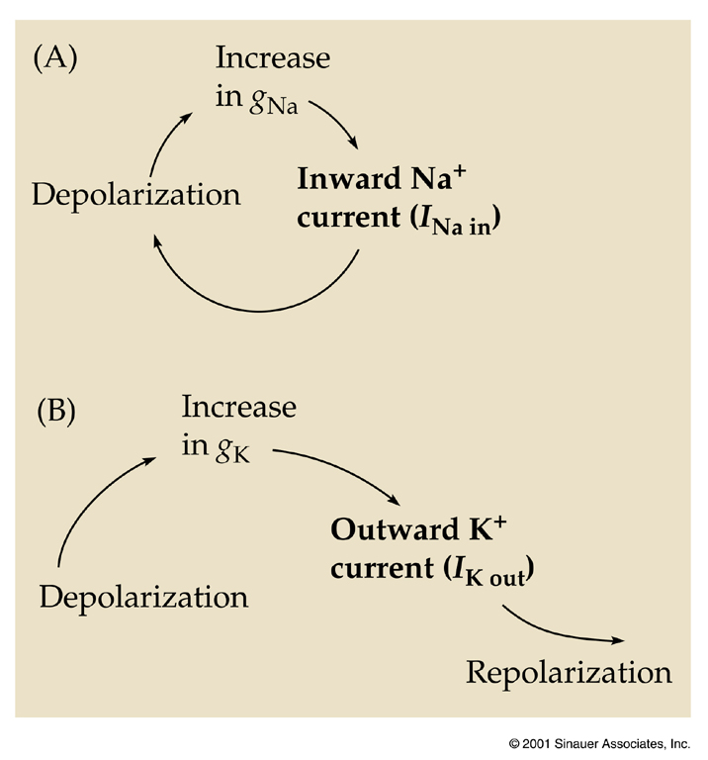
Sequence of Events
www.pmcol.ualberta.ca/student/The_Hodgkin-Huxley_Equations_2.ppt

Slide 3
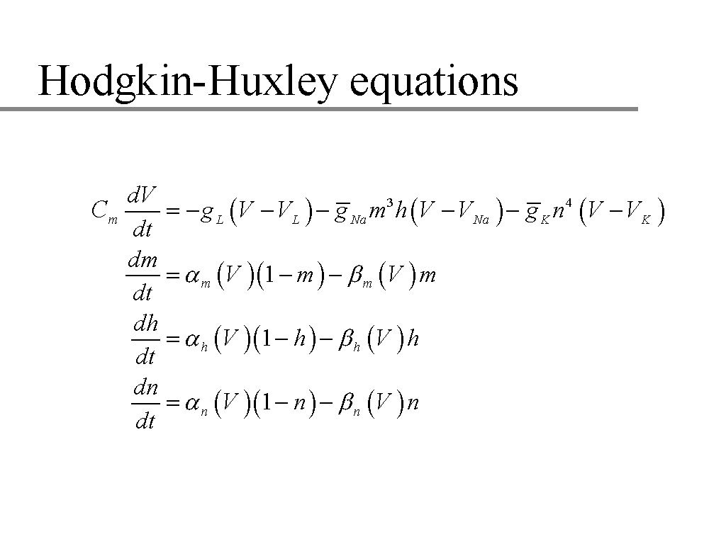
A.L. Hodgkin and A.F. Huxley, J. Physiol. Vol 117 500-540, 1952
m, n, and h are gate variables
Notes:
Need to know the rate constants for each of the three gating equations, and the conductances. The first equation is a change in charge, i.e. a differential equation of current.

Slide 4
Can figure out g_{K}, g_{Na} and g_{Cl} from equations:
_
I_{K} = n⁴g_{K}(V_{m}- E_{K})
_
I_{Na} = m³hg_{Na}(V_{m}- E_{Na})
I_{Cl} = g_{Cl}(V_{m}- E_{Cl})
A.L. Hodgkin and A.F. Huxley, J. Physiol. Vol 117 500-540, 1952
Notes:
Opening and closing of the potassium ion channels is given by the activation gate n , while the sodium channels are governed by the activation gate m and the inactivation gate h .
Why is n raised to the 4th power? See next slide.

Slide 5
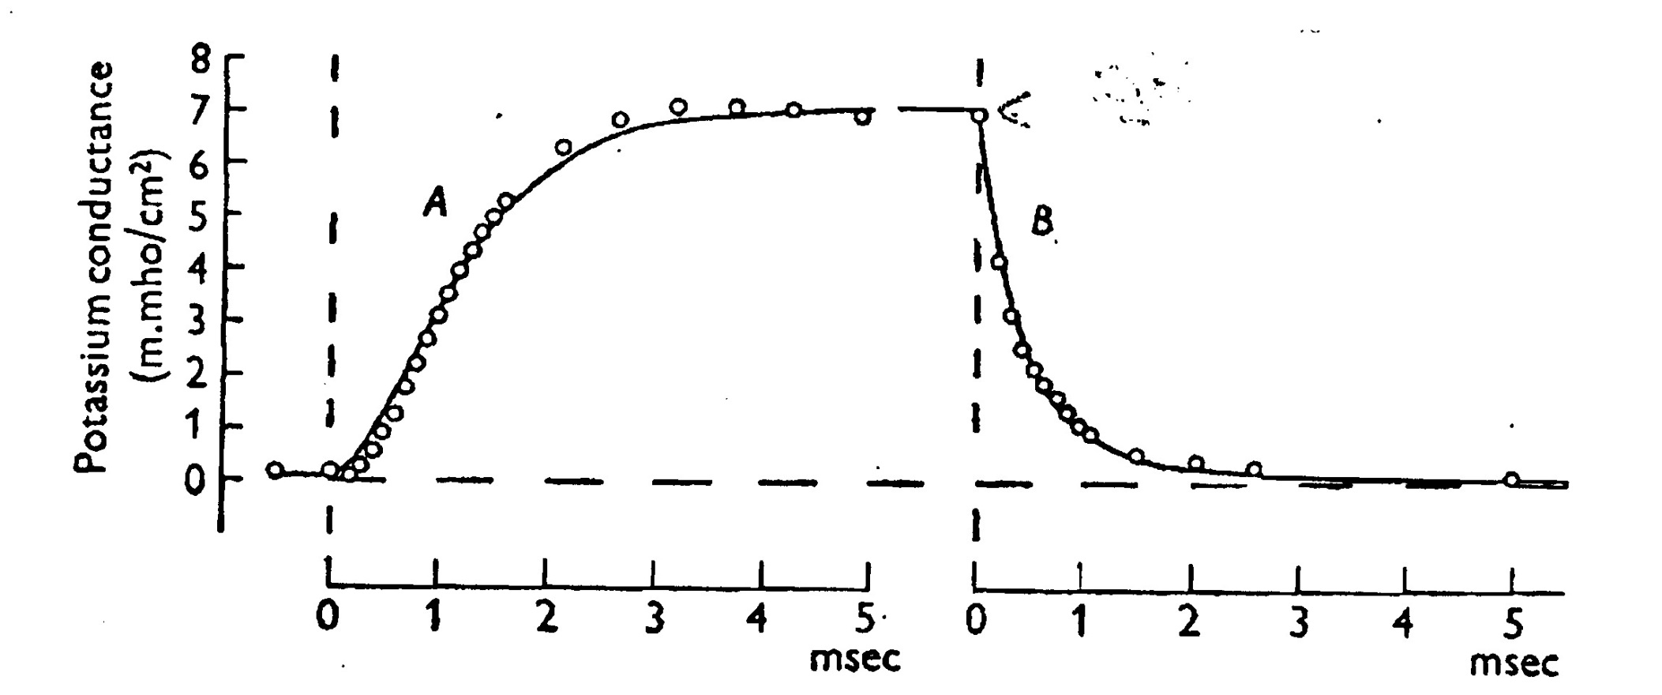
Change in g_{K}
Notes:
Depolarization of +25 mV, repolarization back to resting potential.
The repolarization induced fall in g_{K} can be fitted with a first-order equation, however, the depolarization can only be explained by a 3rd or 4th order equation (1 – exp(-t)⁴). Note the presence of an inflection point (a “kink”) in the rising phase of the curve which would imply the use of a higher-order equation (an inflection point is a point in the curve at which the 2nd derivative changes sign, or when the tangent to the curve does not kiss the curve but rather crosses it). In this curve, the red point is when the 1st derivative stops increasing (but continues to remain positive nonetheless in the figure above) and begins decreasing, which means that the 2nd derivative changes sign, i.e. the point is an inflection point.
Alternatively, g_{K} is proportional to the 4th power of a variable that itself obeys a first-order equation. This variable is n—the fraction of K⁺ channels that are open.

Slide 6
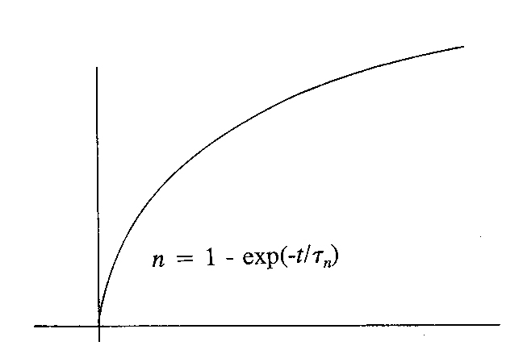
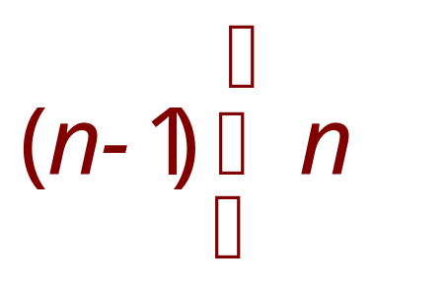
Single Exponential Curve
If conductance change required only one event,
dn/dt = α(1-n) - ßn
then curve would be a simple exponential with a time constant of τ (tau)
www.pmcol.ualberta.ca/student/The_Hodgkin-Huxley_Equations_2.ppt

Slide 7
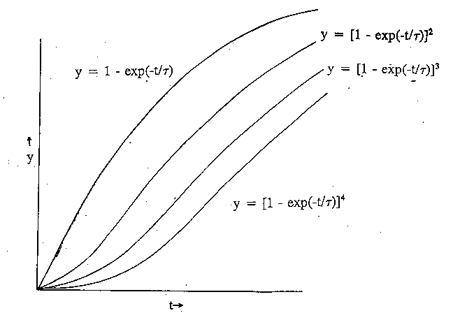
Exponential Raised to a Power
Exponentials raised to a power more closely resemble observed conductance changes
www.pmcol.ualberta.ca/student/The_Hodgkin-Huxley_Equations_2.ppt

Slide 8
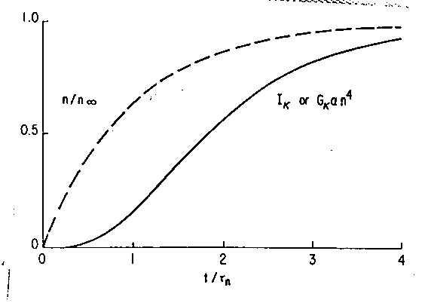
Gate Opening vs Channel Opening
Fraction of gates open and fraction of channels open.
www.pmcol.ualberta.ca/student/The_Hodgkin-Huxley_Equations_2.ppt

Slide 9
Rates of Opening and Closing
  Rate that channels open for any given voltage step is dependent on the proportion of unopened channels multiplied by the opening rate constant MINUS the rate of simultaneous channel closing; i.e. the fraction already open multiplied by the closing rate constant
dn/dt = α(1-n) - βn
www.pmcol.ualberta.ca/student/The_Hodgkin-Huxley_Equations_2.ppt

Slide 10
Open Fraction as a Function of Rate Constants
When membrane voltage is constant
dn/dt = 0
Then n = α
(α + β)
i.e. Fraction of channels open at any constant
voltage is determined from a combination
of rate constants of opening and closing
www.pmcol.ualberta.ca/student/The_Hodgkin-Huxley_Equations_2.ppt

Slide 11
The solution of dn/dt that satisfies the boundary condition n = n₀ when t = 0 is
n = n∞ - (n∞ – n₀)exp(-t/τ_{n})
n∞ = α_{n}/(α_{n} + β_{n})
τ_{n} = 1/(α_{n} + β_{n})

Slide 12
From K⁺ conductances obtained experimentally,
we can calculate g_{K∞} (asymptotic conductance).
n = n∞ - (n∞ – n₀)exp(-t/τ_{n})
_
g_{K} = g_{K}n⁴
_
g_{K} = g_{K} [g_{K∞}^{1/4} - (g_{K∞}^{1/4} – g_{K0}^{1/4})exp(-t/τ_{n})]⁴
Notes:
gK∞ = gK n∞^4

Slide 13
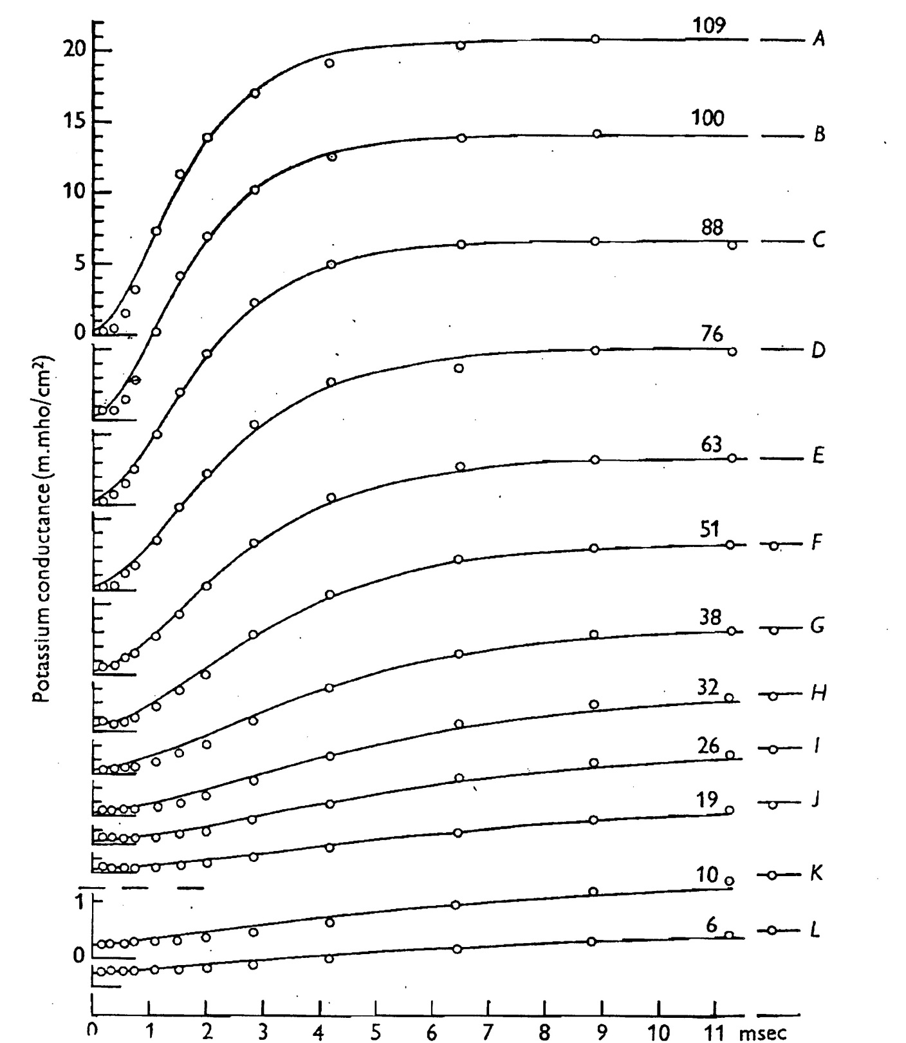
g_{K}

Slide 14
Using equation for g_{K},
smooth curves in figure calculated.
τ_{n} chosen to give best fit to experimental curves.

Slide 15
_
g_{K} is the maximum conductance.
Assume that n = 1 at the asymptote which is
taken as about 20% greater than the value of
g_{K∞} at a depolarization of 109 mV.
g_{K∞} = 20 mS/cm² at a depol. of 109 mV
(see curve).
_
Therefore, g_{K} ~ 24 mS/cm²

Slide 16
_
n∞ is thus calculated from equation g_{K∞} = g_{K}n∞ ⁴
Now, we know n∞(V) and τ_{n}(V).
We need to calculate rate constants α_{n} and β_{n}.

Slide 17
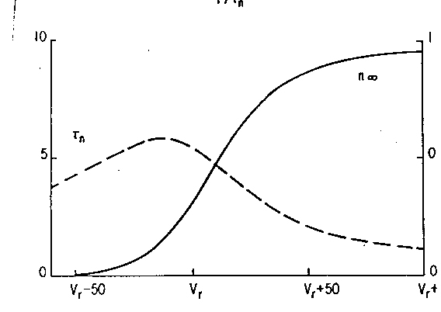
Potassium Activation Variable and Time Constant vs Voltage
www.pmcol.ualberta.ca/student/The_Hodgkin-Huxley_Equations_2.ppt

Slide 18
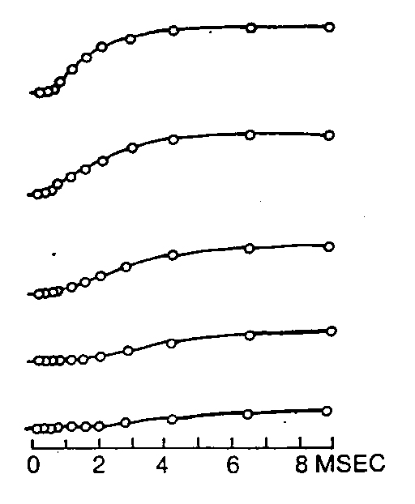
Rate Constants α_{n} and β_{n} are Voltage Sensitive
+44 mV
Potassium conductance changes become more rapid at higher voltage steps
+23 mV
-2 mV
-27mV
-39 mV
www.pmcol.ualberta.ca/student/The_Hodgkin-Huxley_Equations_2.ppt
Notes:
20-50% more rapidly at large depol than at V = -100 mV.

Slide 19
From n∞(V) and τ_{n}(V),
we can calculate the rate constants α_{n}(V), β_{n}(V)
at different voltages using equations:
α_{n}(V) = n∞(V) / τ_{n}(V)
β_{n}(V) = (1 - n∞(V)) / τ_{n}(V)
Finally, plug in the values of α and β into the
H-H ODEs.

Slide 20
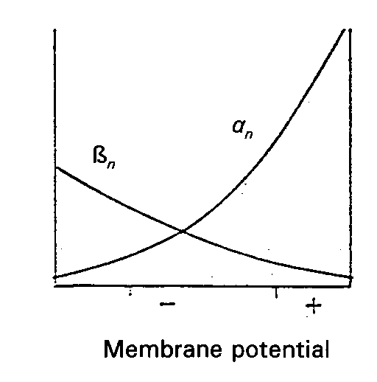
Voltage Relationships of Rate Constants
Closed to open transition rate increases with increasing voltage steps from resting potential. Open to closed rate decreases over same range
www.pmcol.ualberta.ca/student/The_Hodgkin-Huxley_Equations_2.ppt

Slide 21
Reality Check (recap)
Curves (potassium conductance curves from a previous slide) do not look like simple exponentials
www.pmcol.ualberta.ca/student/The_Hodgkin-Huxley_Equations_2.ppt

Slide 22
Potassium Channels (recap)
When all potassium channels are open
        __
g_{K} = g_{K}
When a fraction n of the gates are open and there are c identical gates in a channel the conductance is given by:-
_
g_{K} = g_{K}n^{c}
Empirically c = 4
www.pmcol.ualberta.ca/student/The_Hodgkin-Huxley_Equations_2.ppt

Slide 23
When the voltage across a membrane changes suddenly, the fraction n changes according to the first order equation:-
dn/dt = (n∞ – n)/τ_{n}
n is reserved for potassium channels
Rate constants of activation and deactivation are α_{n} and β_{n}
τ_{n} is the time constant of the exponential curve describing the change in n with time for a given voltage step
www.pmcol.ualberta.ca/student/The_Hodgkin-Huxley_Equations_2.ppt

Slide 24
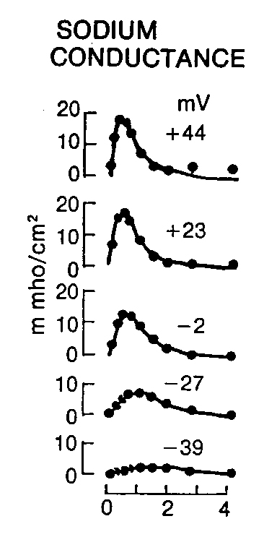
Sodium Conductance Activation and Inactivation
Rates of both activation and inactivation increase with increasing voltage steps.
www.pmcol.ualberta.ca/student/The_Hodgkin-Huxley_Equations_2.ppt

Slide 25
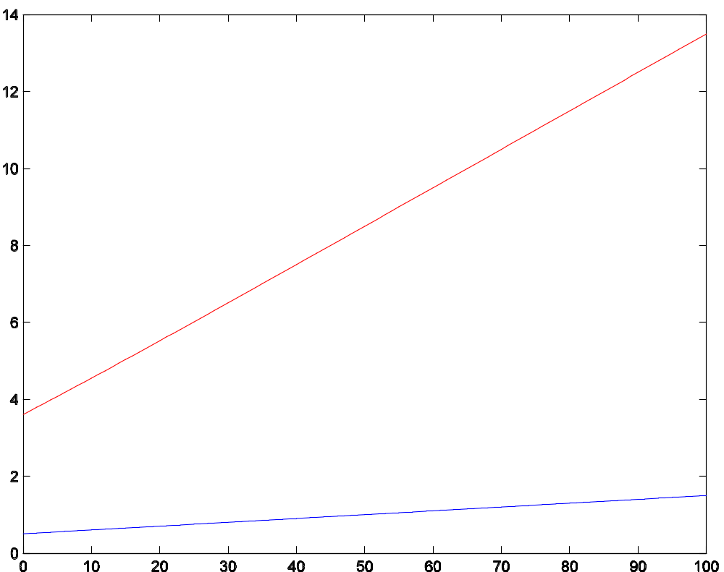
Opening rate constants
α_{m}
α_{n}
Depolarization (mV)
Notes:
Note the rate constants increase with voltage for both Na⁺ and K⁺ channels. Also note that the rate constant for Na⁺ activation is greater than that for K⁺ activation and the difference increases with increasing voltage. This implies that at large depolarizations, there is a far greater push for the Na⁺ channels to get open. This voltage-dependent difference contributes to the fast rise in inward current during the AP.

Slide 26
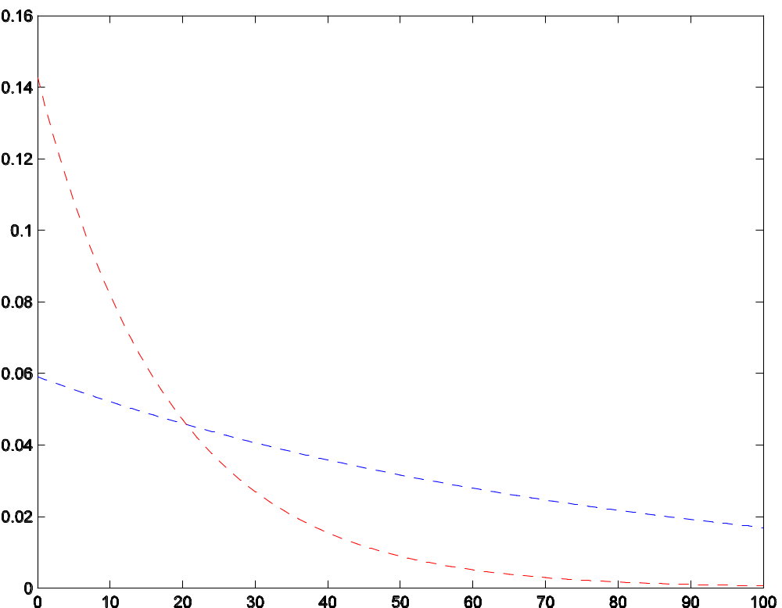
Closing rate constants
β_{n}
β_{m}
Depolarization (mV)
Notes:
Note the rate constants for Na⁺ closing and K⁺ closing cross at around 22 mV. This implies that at large depolarization steps, there is much less push to close Na⁺ channels.

Slide 27
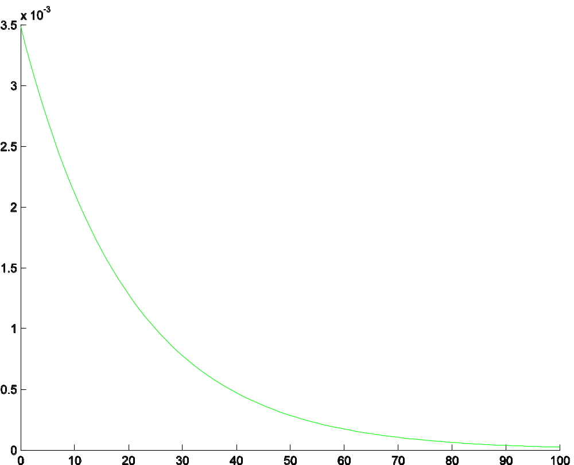
Na⁺ inactivation rate constants-I
α_{h}
Depolarization (mV)
Notes:
Note α_{h} and β_{m} have similar shapes. They perform similar functions in a broad sense—to prevent Na⁺ ions from flowing through the Na channel.

Slide 28
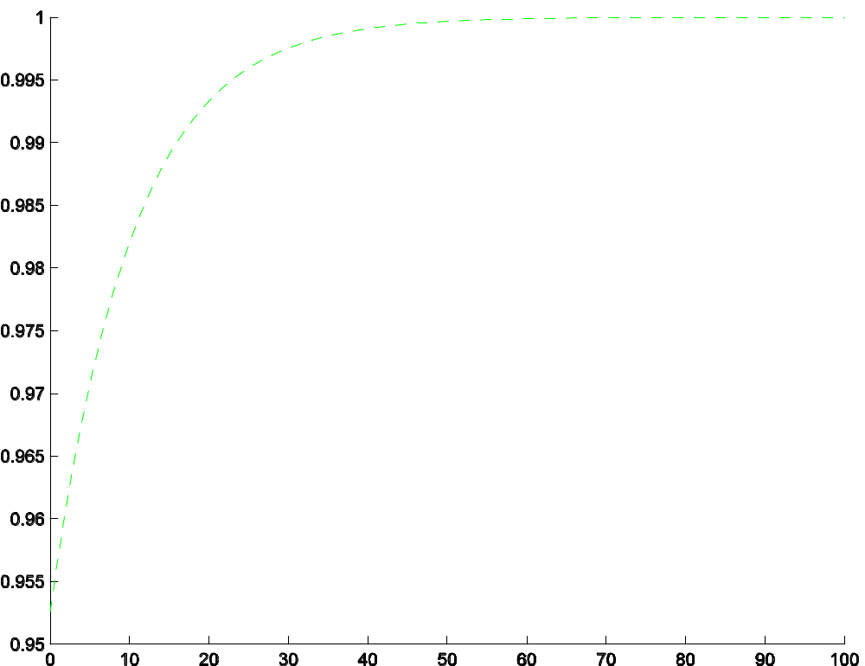
Na⁺ inactivation rate constants-II
β_{h}
Depolarization (mV)
Notes:
Closed to open rate for activation gates (am, an) increase with greater voltage steps, while that for inactivation gates (ah) declines.
Opposite for open to close rates (b).

Slide 29
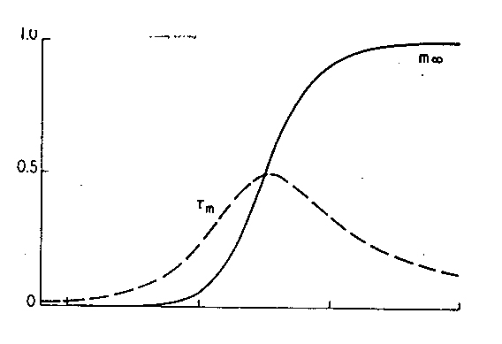
Sodium Activation Variable and Time Constant vs Voltage
www.pmcol.ualberta.ca/student/The_Hodgkin-Huxley_Equations_2.ppt

Slide 30

Inactivating Channels
m is the activation variable for the sodium channels
Conductance measurements are best fitted by assuming g_{Na} varies as m³
Inactivation needs only one gate
Voltage dependence is reversed, but kinetics are the same
dh/dt = α_{h}(1 – h) –β_{h}h
_
g_{Na} = g_{Na}m³h
www.pmcol.ualberta.ca/student/The_Hodgkin-Huxley_Equations_2.ppt

Slide 31
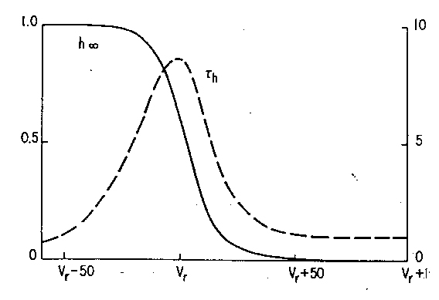
Sodium Inactivation Variable and Time Constant vs Voltage
www.pmcol.ualberta.ca/student/The_Hodgkin-Huxley_Equations_2.ppt

Slide 32
A.L. Hodgkin and A.F. Huxley, J. Physiol. Vol 117 500-540, 1952
m, n, and h are gate variables
Notes:
Need to know the rate constants for each of the three gating equations, and the conductances.

Slide 33
α_{n} = 0.01(V + 50) / [1. - exp(-(V+50)/10)]
β_{n} = 0.125 exp(-(V+60)/80)
α_{m}= 0.1(V + 35) / [1. - exp(-(V+35)/10)]
β_{m}= 4.0 exp(-(V+60)/18)
α_{h}= 0.07exp(-(V+60)/20)
β_{h}= 1./(1 + exp(-(V+30)/10)
Note: Similarity between β_{n} and α_{h}.

Slide 34
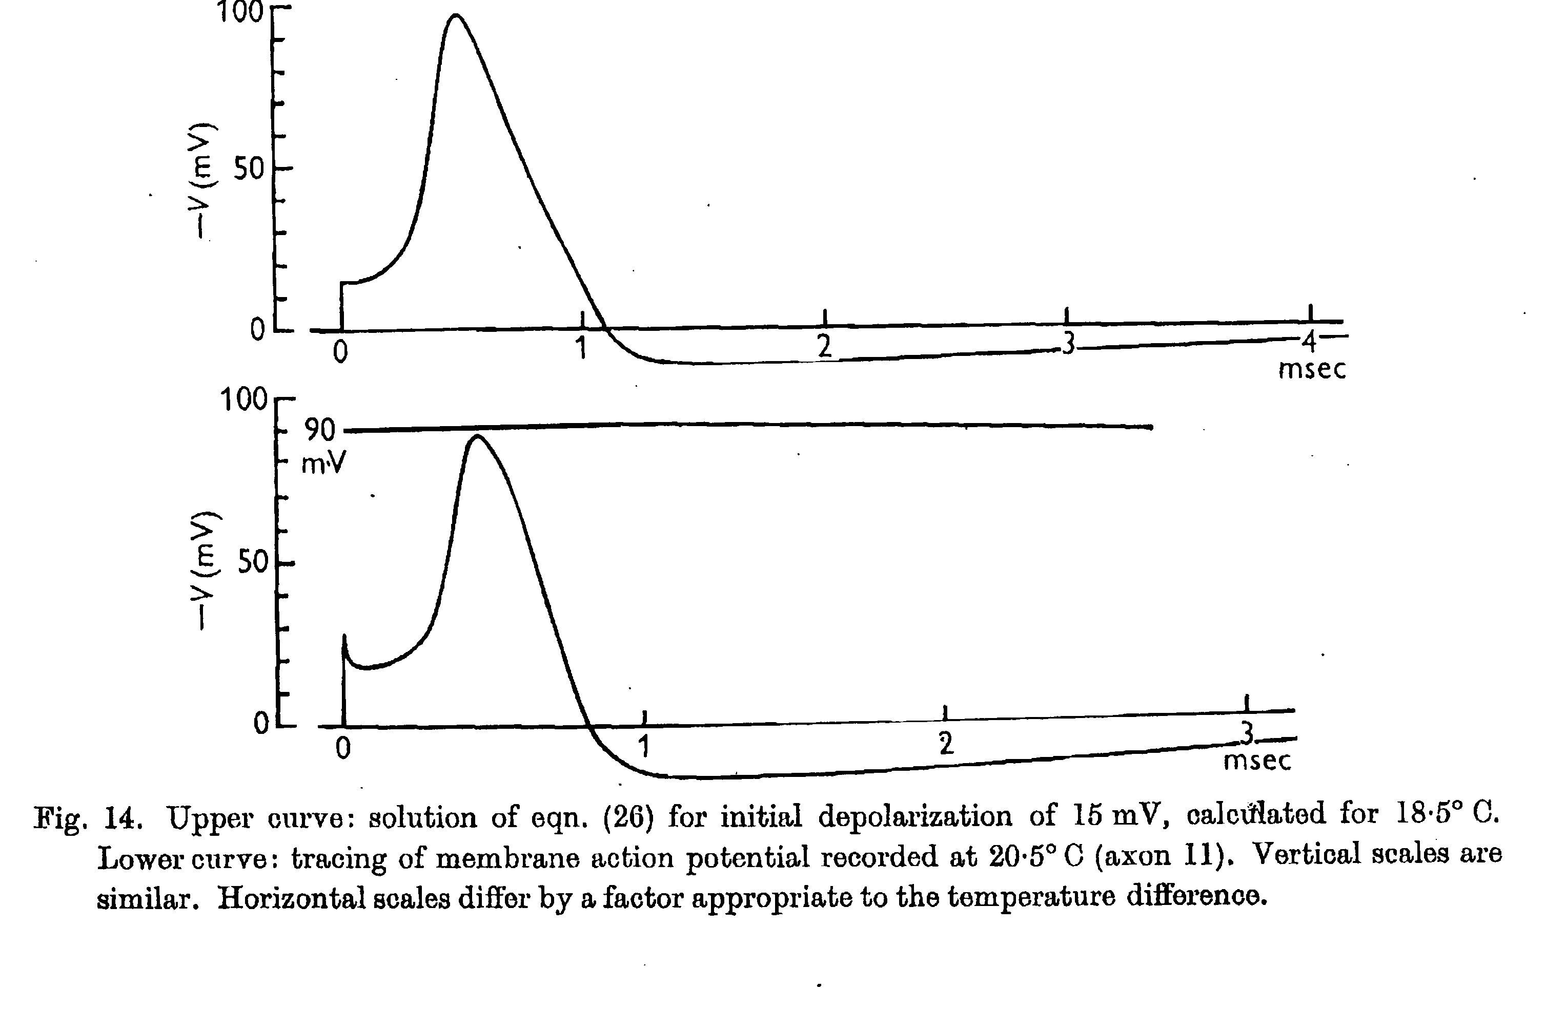
Results of simulation (H&H, 1952)
Notes:
Note that even though there was some curve-fitting (e.g. a 4th order exponential rather than a 1st order exponential solution, calculation of the Na and K activation time constants from the exponential fit) and fudge factoring (the calculation of Na and K conductances, for instance), there is something beautiful about the exercise and this is it:: Nowhere in the model or in the equations is the AP explicitly modeled. The AP is an emergent property of the exercise, and that’s the true beauty of the H-H equations.

Slide 35
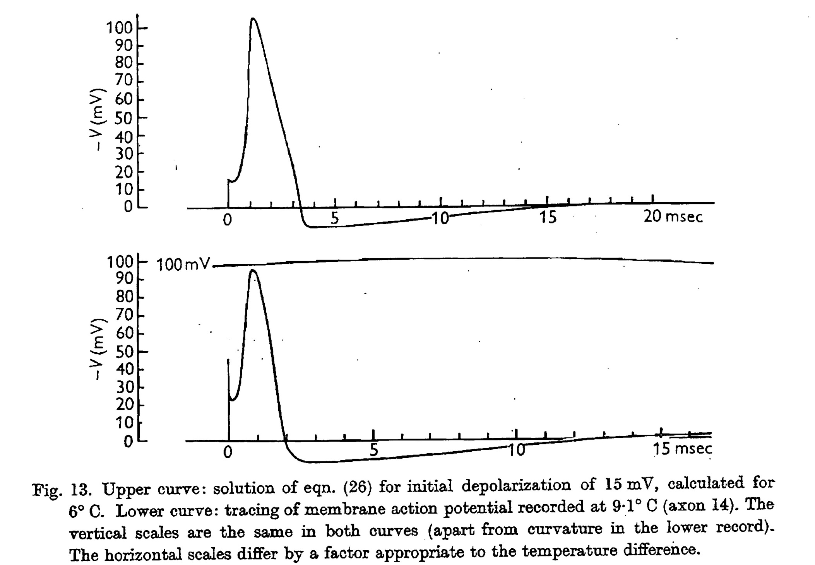
Results of simulation-II, H&H, 1952

Slide 36
Review
H-H equations
Solution of 1st order ODE.
Steps in deriving equations:
- Ohm’s Law
- Add gating variables
- Why gating variables raised to a power? Both experimental and computational reasons
- Obtain maximum conductance. How?
- Obtain n∞ and τ. How?
- From this, obtain α and β. How?
Figures of opening, closing etc. rate constants and relationships among them.
Na vs. K conductance differences→Na channel inactivation idea.
How does equation yield the non-linear AP?

